Slide 1
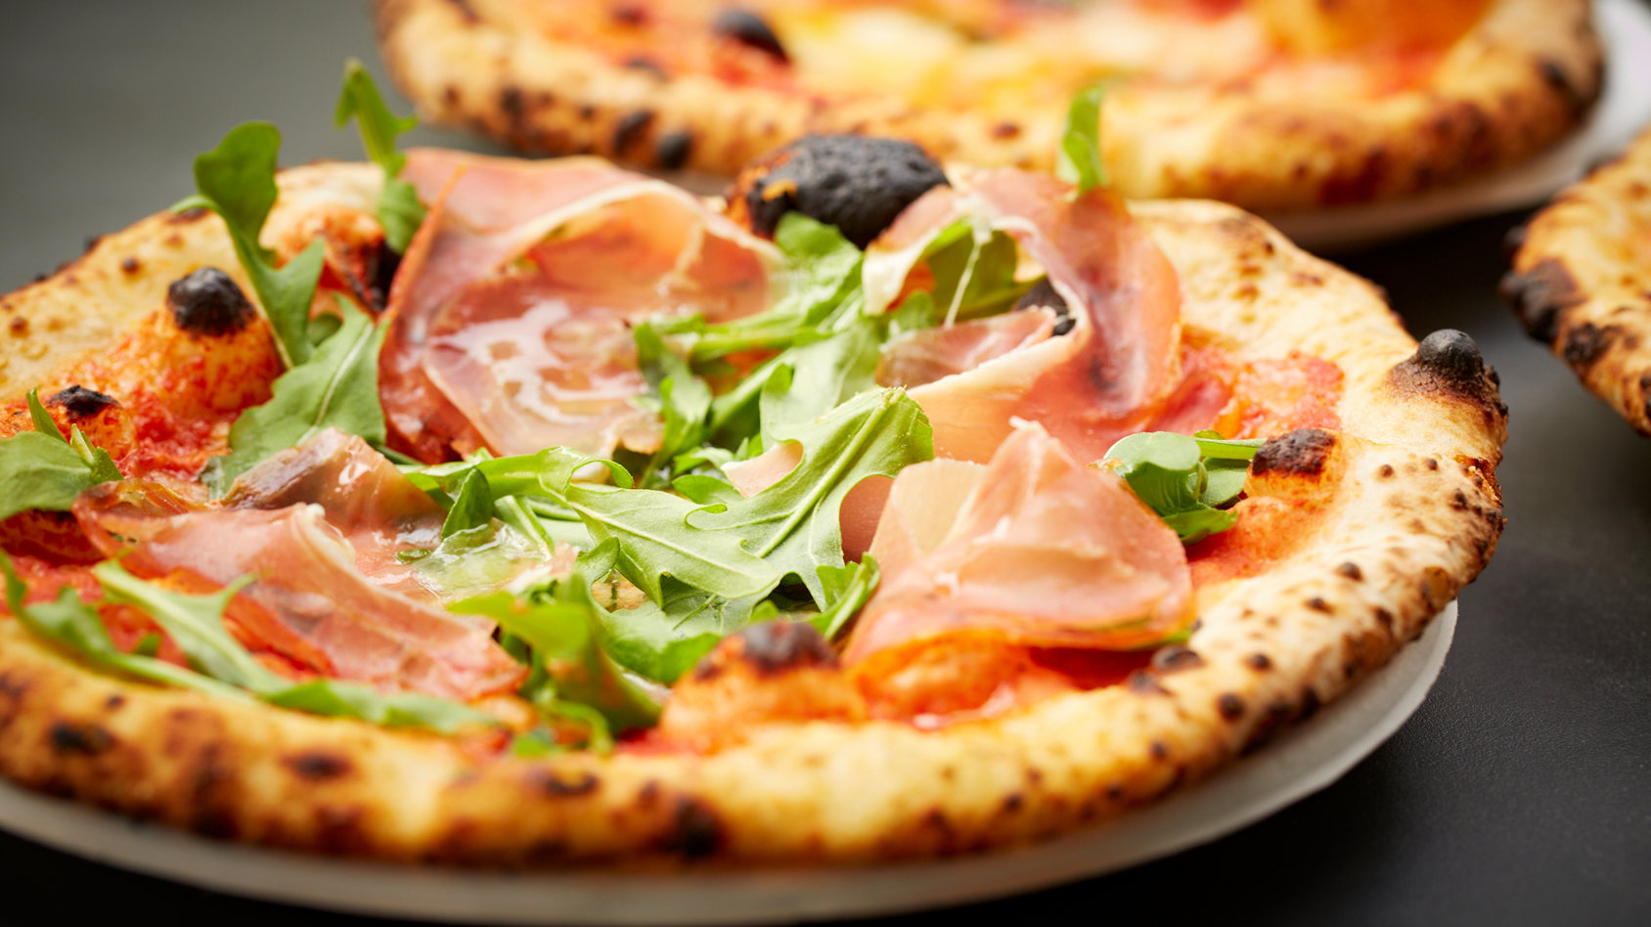
THE TWO PIZZA RULE

Slide 2

The two-pizza rule came from Jeff Bezos the CEO of Amazon
The idea is that any team should be small enough to be fed by two pizzas which is roughly 5-7 people. Its to avoid the meeting becoming so large that nothing gets done.

Slide 3


Keep your meetings productive
We want to keep the meetings at 5-7 people to give everyone a chance to be heard in the meeting.

Slide 4
Customize your meetings
You can customize your meetings by customizing who is in the room. For instance, it is not always necessary to have the Sales team people in a meeting about Marketing. By arranging the meeting better, you can allow for more productive discussions .

Slide 5
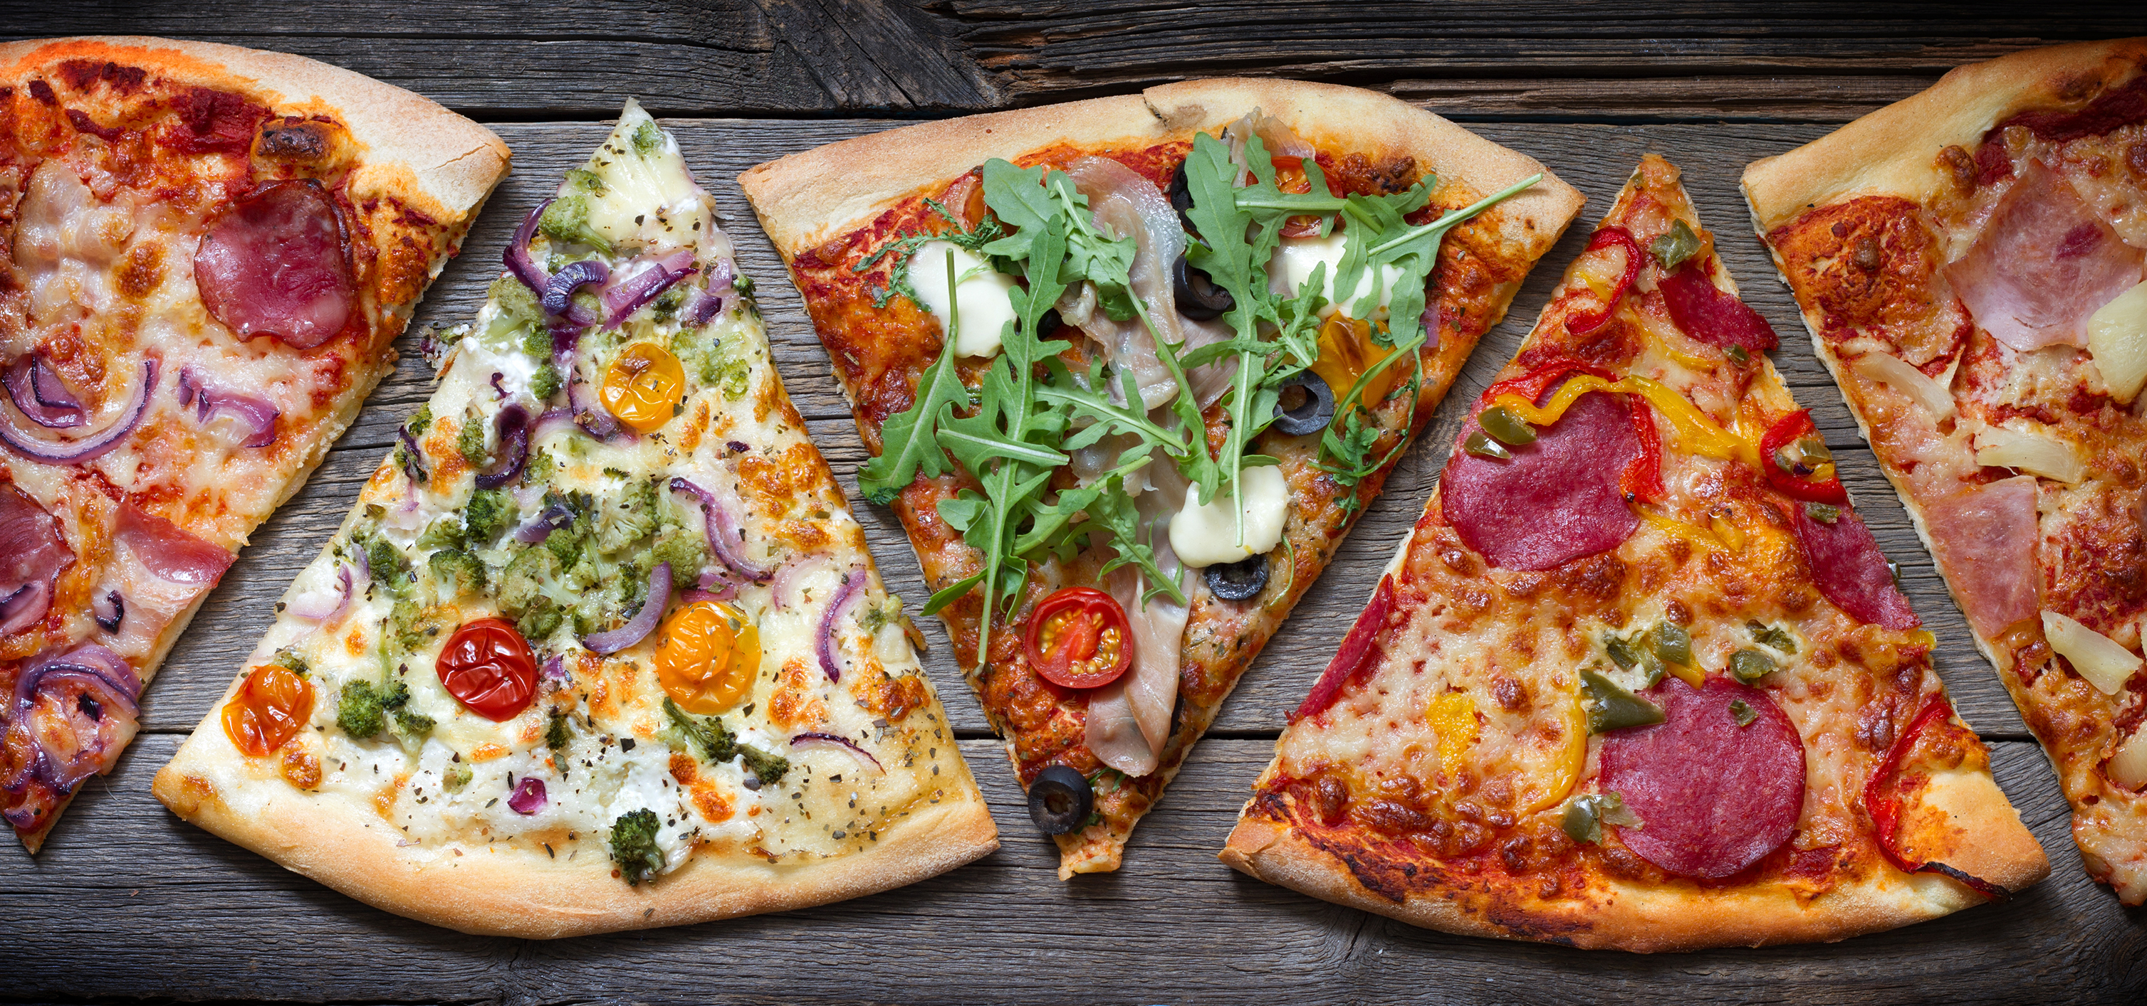
You can always add more to your meetings (but not too much)
By including an individual from another “piece of the pizza pie” from the office, for example, a software engineer, you are creating a streamlined flow of communication to the office.
https://bitrebels.com/business/what-exactly-is-two-pizza-team-rule/

Slide 6



Have you seen efficiency ?
John
Mary
Bill
Yeah its stuck in meetings!

Slide 7


To demonstrate the last slide, take a two-pizza team of five people and count the maximum possible one-on-one connections between the team members. Four for each member means there are a max of 20 two-person communications channels on the team.
4 X 5 = 20
Now double the team members and the number of one-to-one connections jumps to 90
See the point… just like with machinery with every moving part you add the probability of a breakdown increases

Slide 8




encourage creativity
When decision makers re distributed across smaller teams it helps so that making important decisions doesn’t only fall on top management
https://www.summary.com/magazine/amazon-efficiency-and-the-two-pizza-team-rule/

Slide 9



BOOST PRODUCTIVITY
With two-pizza teams the discussion can be more fruitful because team-mates may feel more comfortable talking in smaller groups and expressing their opinions which will boost the team's productivity.

Slide 10


Remember the “two-pizza team rule”
If you concentrate on efficiency and problem solving in the now with content that matters to everyone in the meeting your meetings will be more productive than they ever have been before.

